Slide 1
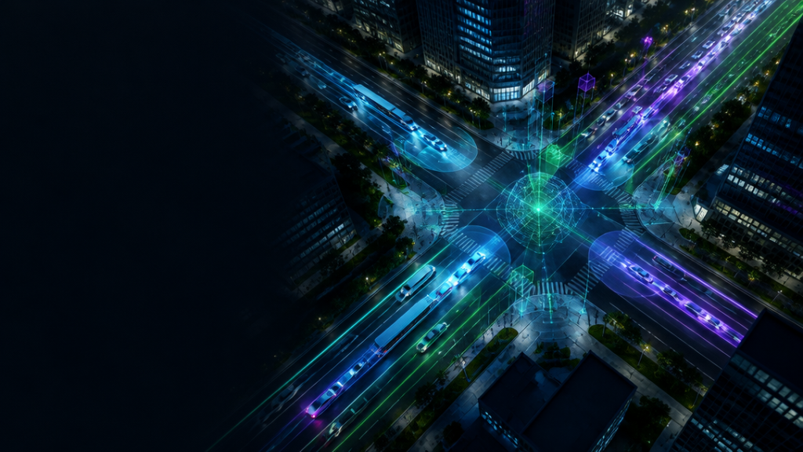
SMART CITIES / FUZZY CONTROL / COMPUTER VISION
CYBERTRAFFIC
AI
Adaptive Signal Control & Vision Nexus
Prepared by:-
Prajapti Dhairya Kishorbhai:-240280103060
Jethava Yash:-240280106056
Patel Krishkumar Rajubhai:- 240280106103
Prajapati Saurav A:-240280106120
08 / 10 / 2026

Slide 2
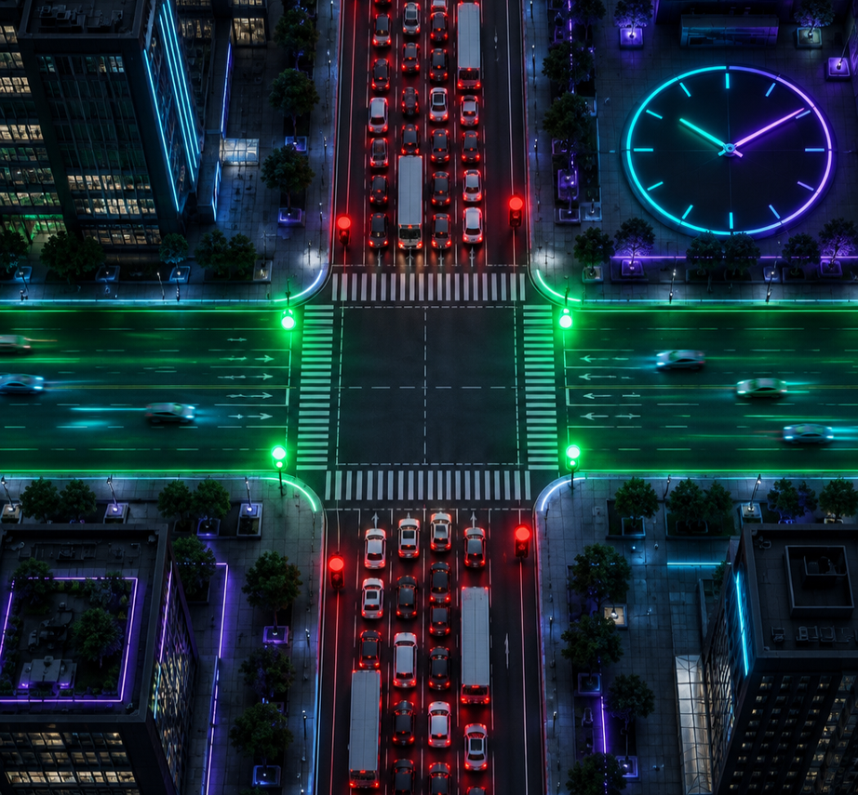
01 / CONTEXT
02
The problem with fixed-time signals
01
Wasted green time
Off-peak lanes stay empty while the timer keeps running.
02
Rush-hour failure
Rigid cycles cannot absorb sudden queue growth.
03
Blind to incidents
No live awareness of ambulances, collisions, or lane blockage.

Slide 3
02 / SYSTEM INTENT
03
System vision & objectives
A Mamdani inference core turns uncertain, live urban conditions into explainable signal decisions.
LINGUISTIC
VARIABLES
MEMBERSHIP
FUNCTIONS
RULE
BASE
SIMULATION
& VALIDATION
Translate queues and waits into human-readable states.
Model gradual transitions instead of brittle thresholds.
Encode expert traffic-control reasoning in nine rules.
Compare adaptive timing against a fixed 45 s baseline.
AI vision supplies real-time density, waiting time, speed and emergency priority.

Slide 4
03 / ARCHITECTURE
04
End-to-end system architecture
AI VIDEO ANALYZER
REAL-TIME TRAFFIC DATA
Detection · tracking
Queue · wait · speed
MAMDANI FUZZY CORE
SIGNAL
CONTROLLER
Fuzzify → infer → centroid
10–90 s
EMERGENCY PREEMPTION
IoT + HISTORY
Priority override
Predictive context

Slide 5
04 / FUZZY MODEL
05
Controller inputs & output
0 — 50
QUEUE LENGTH
vehicles
Current demand pressure
0 — 10
WAITING TIME
minutes
Fairness and accumulated delay
10 — 90
GREEN-LIGHT DURATION
seconds
Adaptive control action

Slide 6
05 / MEMBERSHIP DESIGN
06
Report model vs. HTML implementation
REPORT · COARSER
HTML · FINER
QUEUE · LOW
0 / 25 / 50
QUEUE · LOW
0 / 0 / 15
WAIT · SHORT
0 / 5 / 10
WAIT · SHORT
0 / 0 / 3
DURATION · SHORT
10 / 50 / 90
DURATION · SHORT
10 / 20 / 30
Finer sets react earlier to small changes — improving responsiveness and control precision.

Slide 7
06 / KNOWLEDGE BASE
07
The 9-rule Mamdani matrix
WAIT: SHORT
WAIT: MEDIUM
WAIT: LONG
QUEUE: LOW
SHORT
SHORT
MEDIUM
QUEUE: MEDIUM
SHORT
MEDIUM
LONG
QUEUE: HIGH
MEDIUM
LONG
LONG
EXAMPLE · IF Queue is LOW and Wait is SHORT → Duration is SHORT

Slide 8
07 / COMPUTATION
08
Mamdani inference pipeline & equations
01 FUZZIFY
02 FIRE RULES
μ(x;a,b,c) = max{0, min[(x−a)/(b−a), (c−x)/(c−b)]}
αᵢ = min( μQueue , μWait )
03 AGGREGATE
04 DEFUZZIFY
μAgg(z) = maxᵢ min( αᵢ , μOutputᵢ(z) )
z* = ∫ z·μAgg(z) dz / ∫ μAgg(z) dz
OPTICAL FLOW
speed = pixel displacement × scale / Δt
IF speed > limit → flag violation event

Slide 9
08 / WORKED EXAMPLE
09
Queue = 20 · Wait = 4
INPUT MEMBERSHIPS
ACTIVE RULES
DEFUZZIFIED OUTPUT
Queue: Low 0.2 · Medium 0.8
Wait: Short 0.2 · Medium 0.8
R1 0.2 · R2 0.2 → Short
R4 0.2 · R5 0.8 → Medium
≈ 41.43 seconds
Weighted representative centers: short ≈ 30 s · medium ≈ 50 s
The result is smooth, explainable, and bounded by the 10–90 s control range.

Slide 10
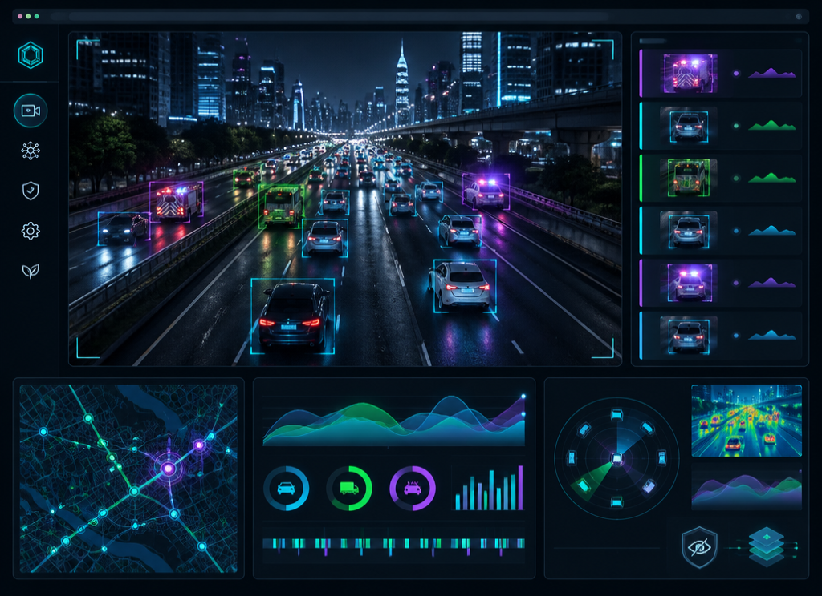
09 / COMPUTER VISION
10
AI video analyzer module
DETECT
Vehicle classes & emergency types
TRACK
Persistent trajectories and counts
ESTIMATE
Queue, wait and road speed
PRIVACY
On-device browser processing

Slide 11
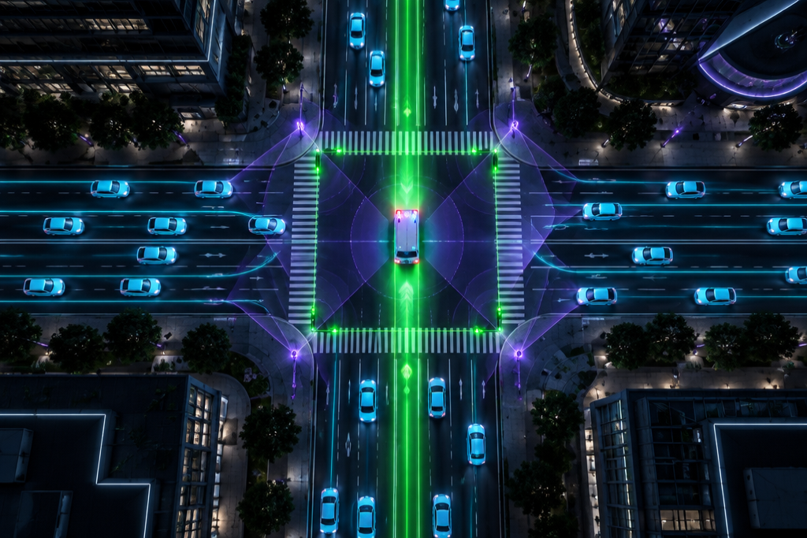
10 / SIMULATION
11
Emergency priority & 4-way simulation
90 s GREEN WAVE
Emergency detection overrides the fuzzy cycle and clears a coordinated corridor.
PAUSE · MODE · RUSH SURGE · AMBULANCE
142
1.84 L
vehicles cleared
idle fuel saved
4.25 kg
CO₂ averted

Slide 12

11 / VALIDATION
12
Benchmark results vs. fixed 45 s
-196.8 s
total delay
+43.8 %
efficiency boost
1.44 L
fuel saved
3.33 kg
CO₂ averted
10 input combinations validated across low, medium, and high-demand scenarios.

Slide 13
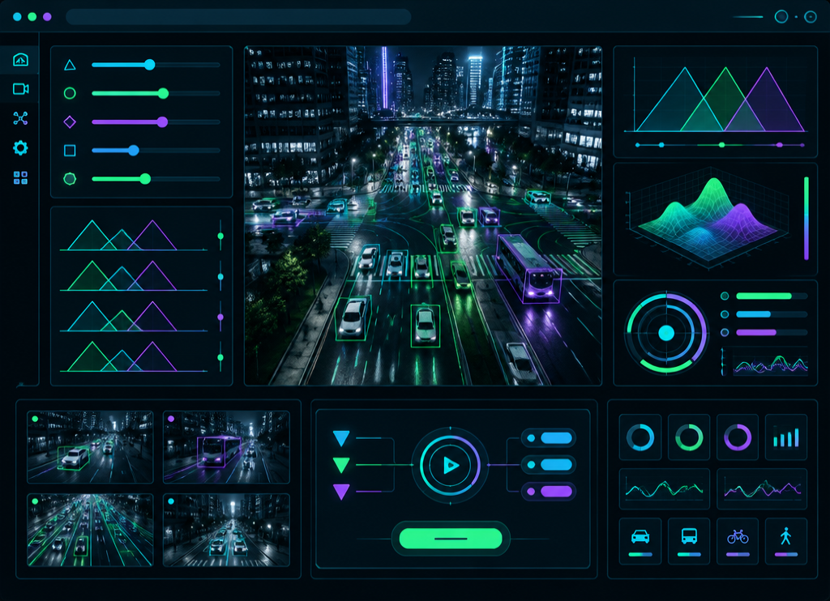
12 / BUILD
13
Implementation & user interface
PYTHON CORE
NumPy + fuzzy ControlSystem classes implement membership, rules and centroid inference.
STREAMLIT UI
Queue and max-wait sliders with a direct calculation workflow.
HTML INTERACTIVE
Live controls, visualizations and video analysis in one modular surface.

Slide 14
13 / REFLECTION
14
Strengths, limitations & future scope
STRENGTHS
LIMITATIONS
FUTURE SCOPE
Less wasted green time
Fairness through wait time
Emergency vehicle priority
Isolated intersection control
Downstream congestion risk
Vision depends on scene quality
Multi-agent city coordination
Weather and environment inputs
Number-plate recognition
Next horizon: coordinated green waves that learn across an entire city network.

Slide 15
14 / CONCLUSION
Human reasoning.
Machine perception.
Better movement.
Fuzzy logic and AI-driven sensing create an explainable, responsive controller that reduces delay, cuts idle emissions, and prioritizes emergency vehicles.
CYBERTRAFFIC AI is a practical step toward adaptive smart-city mobility.
THANK YOU / QUESTIONS?

